Slide 1

ATTENDANCE MONITORING SYSTEM
PROJECT BY:-
SUDHANSHU

Slide 2
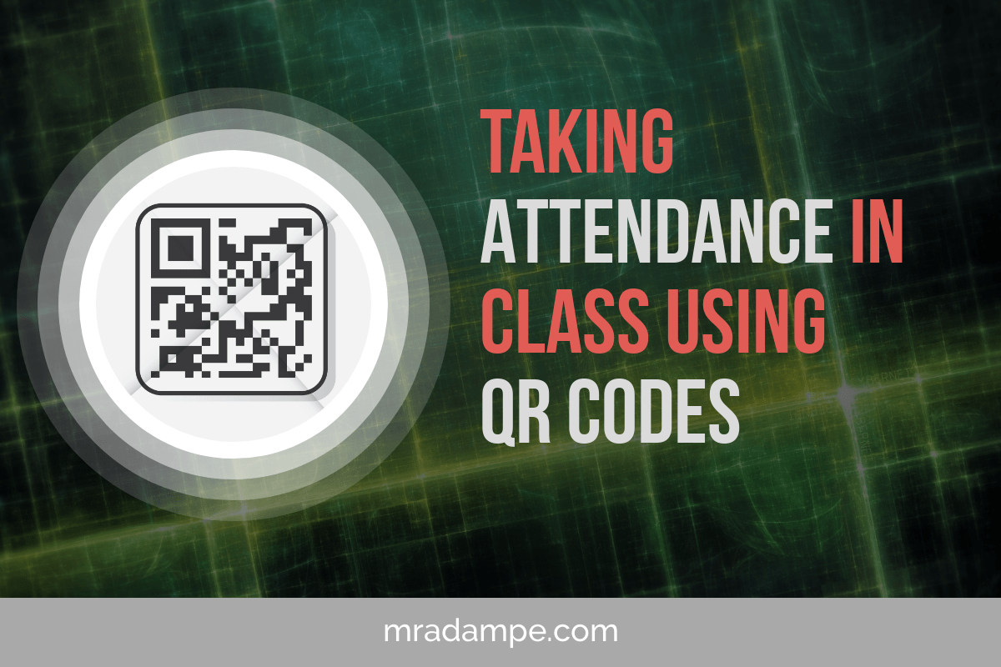

Slide 3
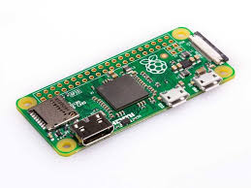
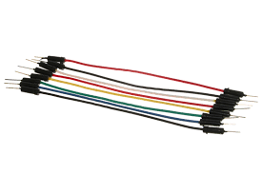

COMPONENTS USED:-
Raspberry Pi- zero
LEDs
Jumper wire

Slide 4
How our model works:-
Our MIT app scans the QR code.
The QR code is processed by our app and sends value of qr code to our thinkspeak.
The programme looks for the id in the database and and marks the attendance upon finding the id.
We can also register a new student, using the 'Admin Login'.
Once the QR code is generated, the new student's attendace gets marked in the similar manner mentioned above.

Slide 5
CIRCUIT DIAGRAM

Slide 6
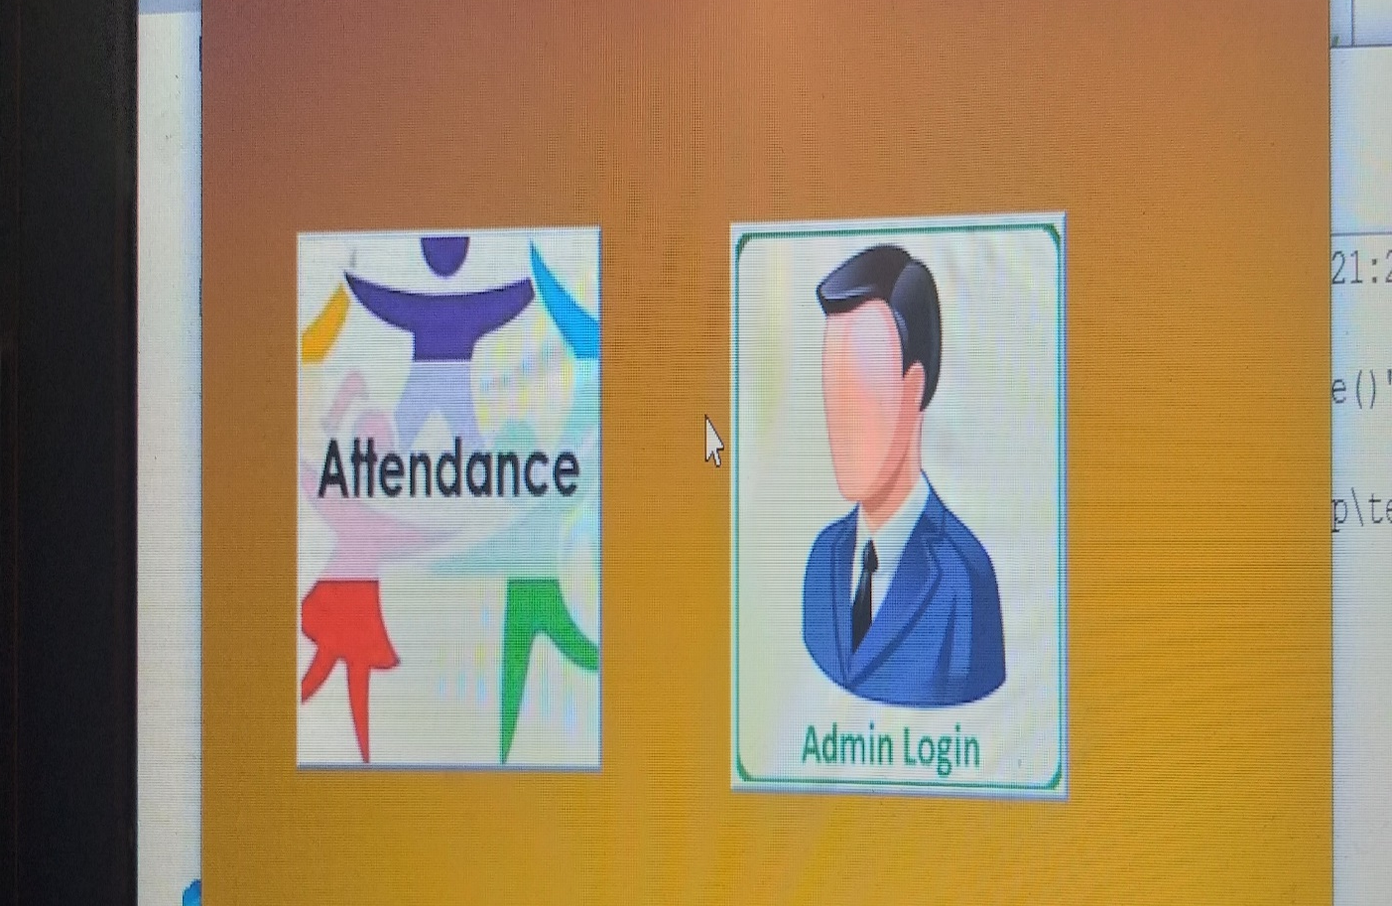
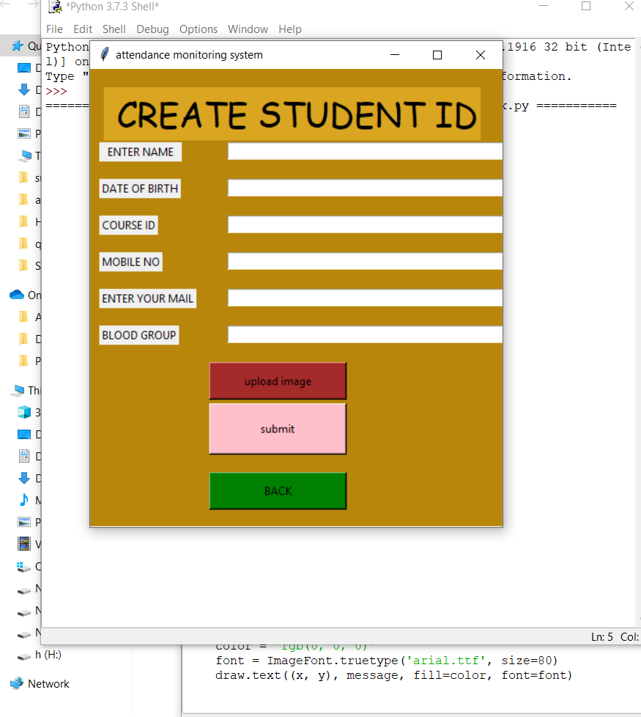

Slide 7
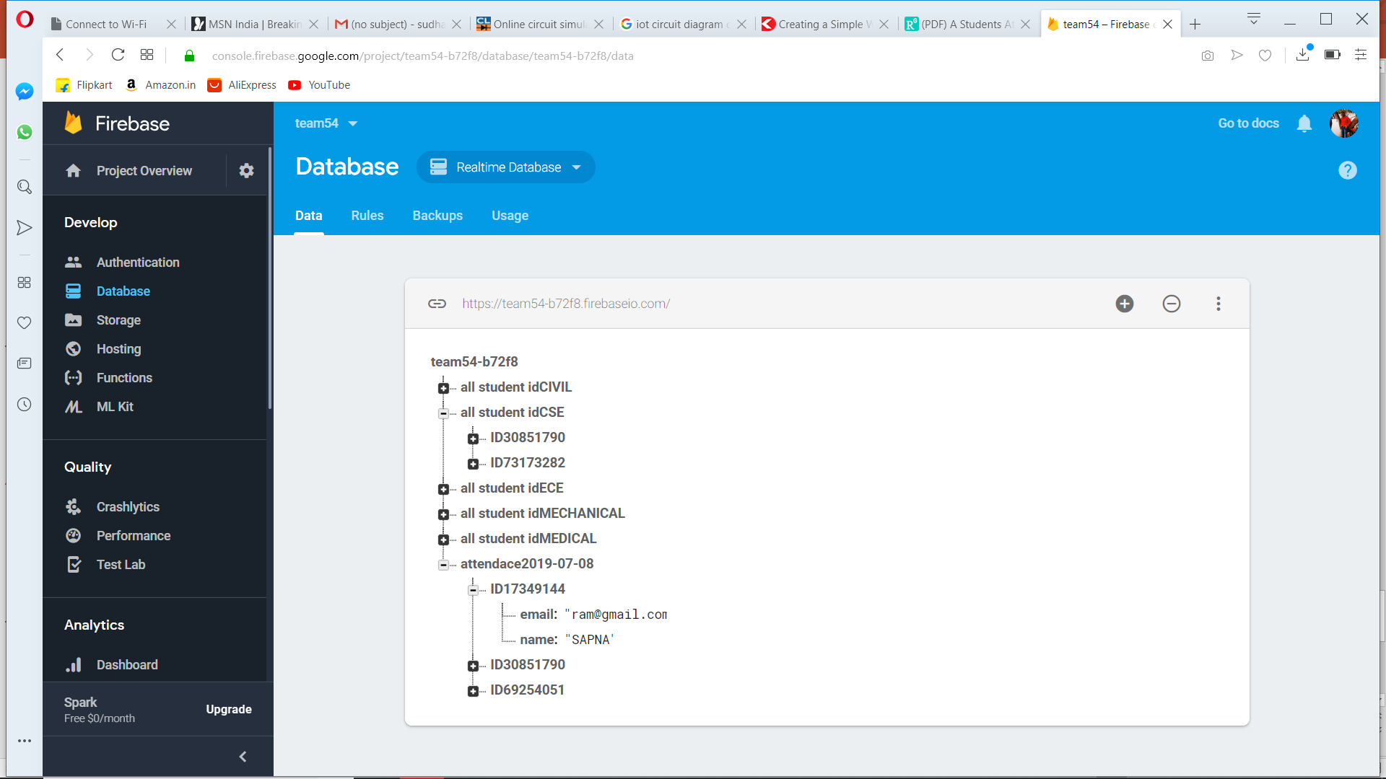
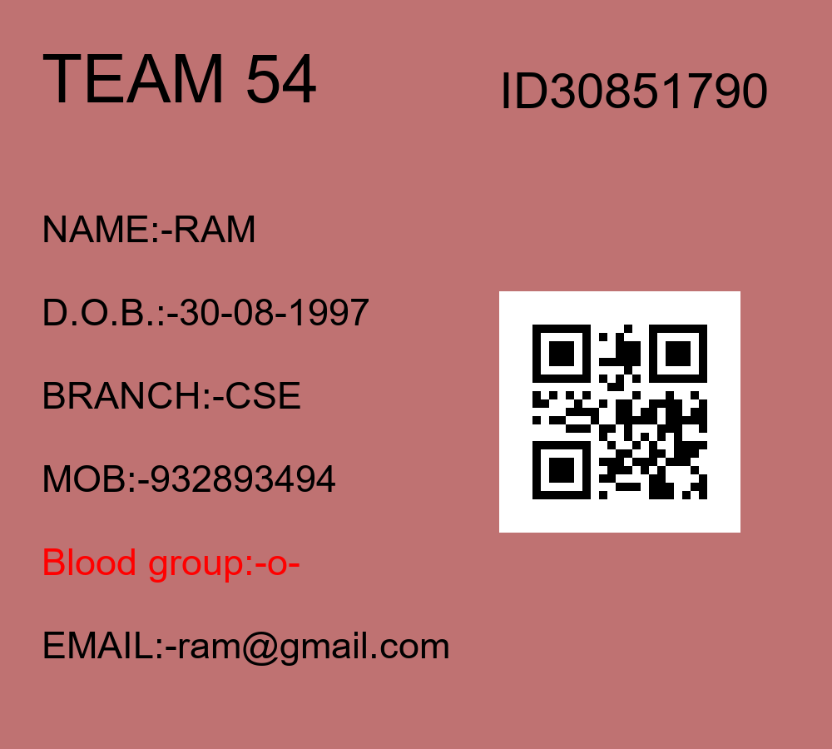

Slide 8
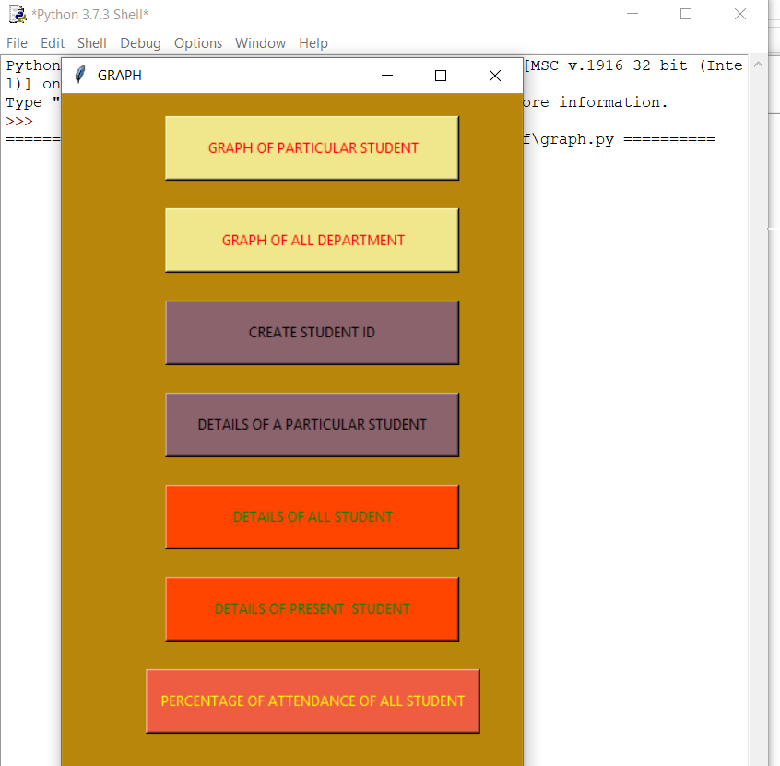
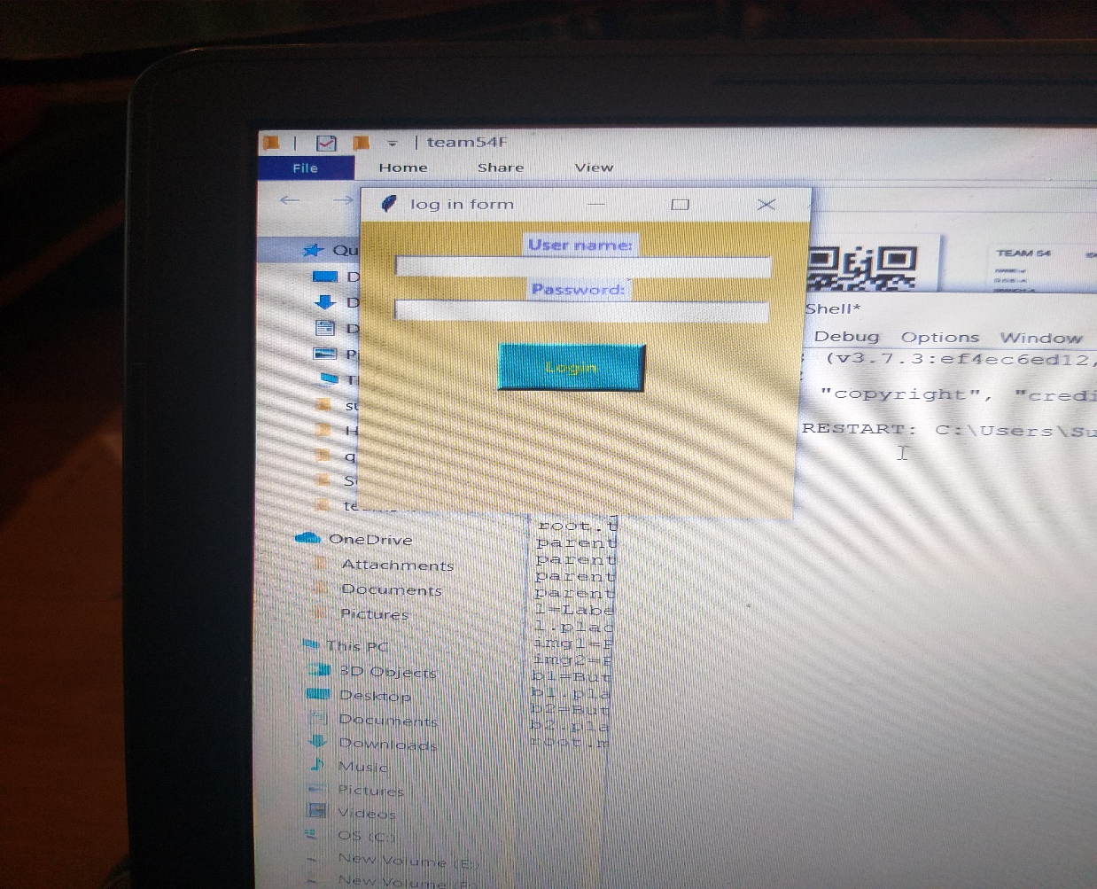

Slide 9
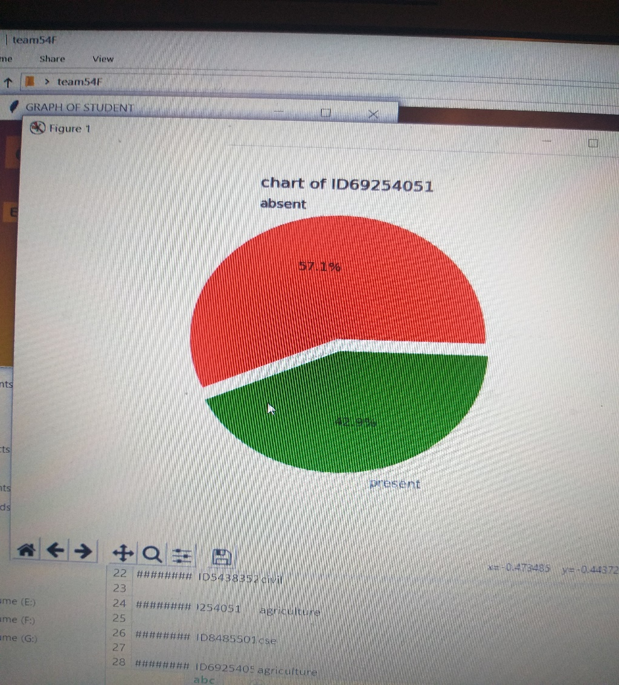
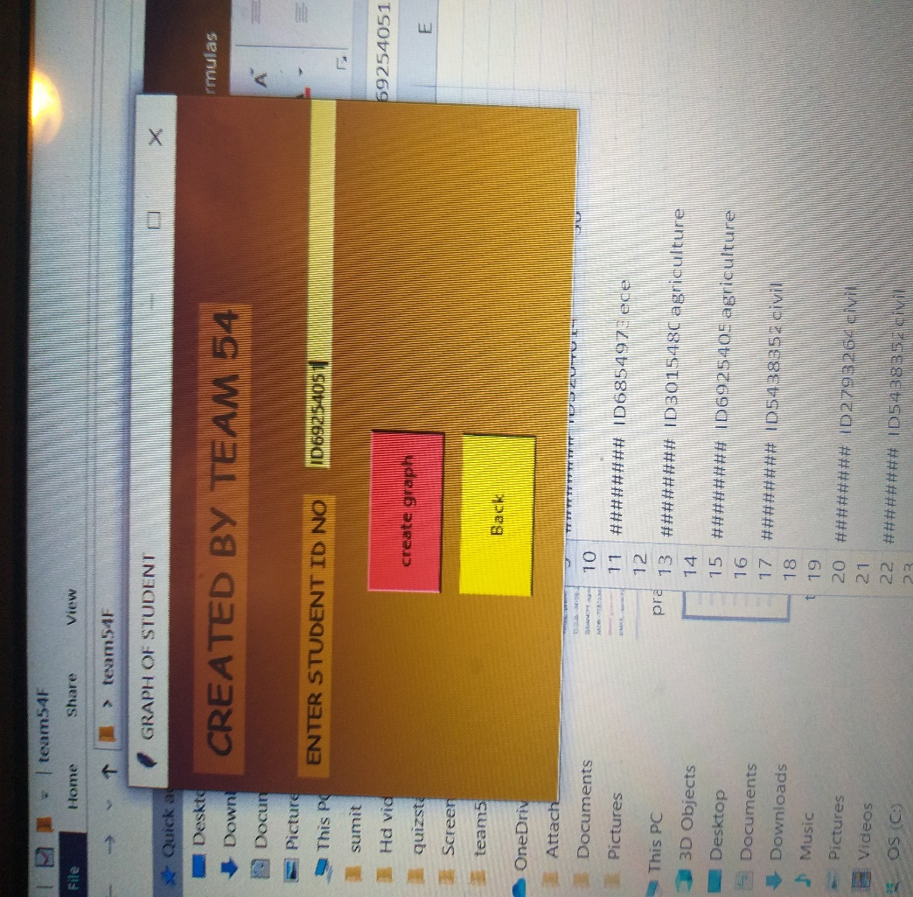

Slide 10
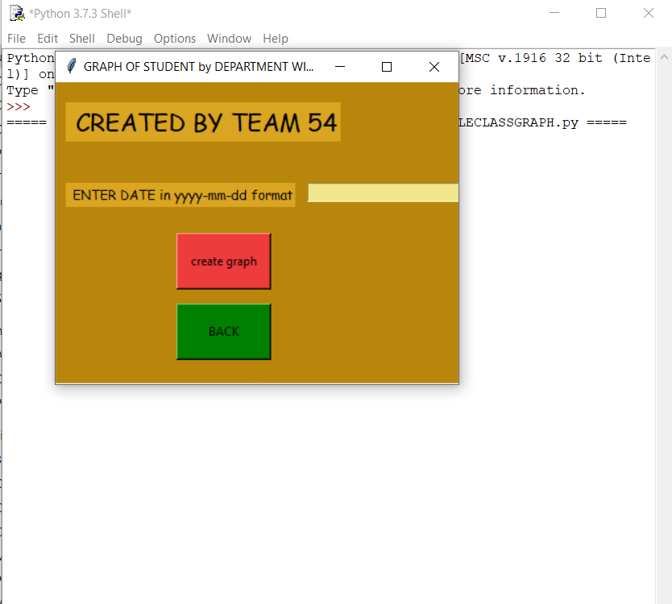
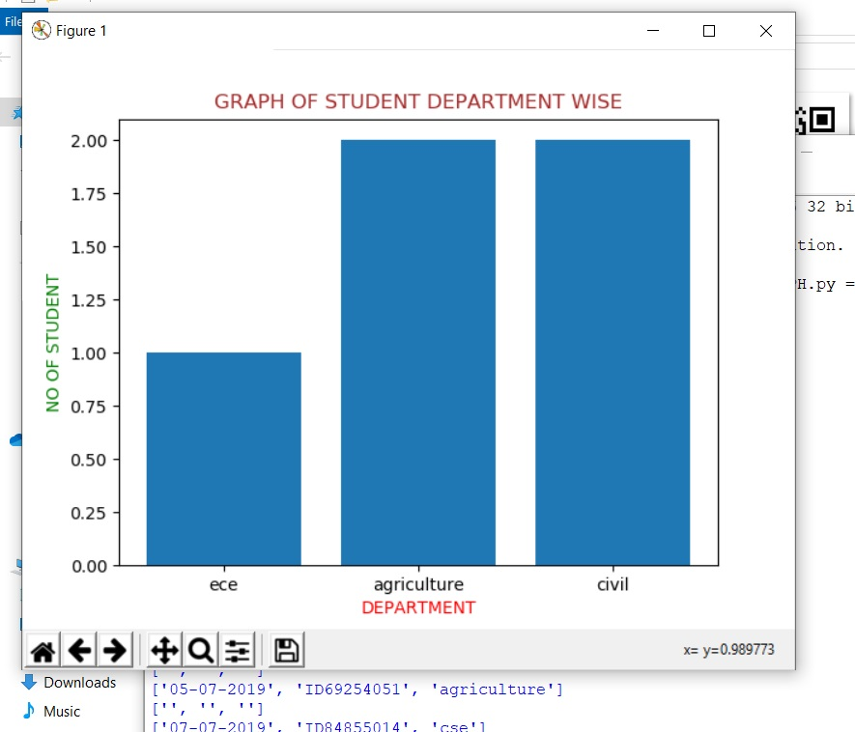

Slide 11
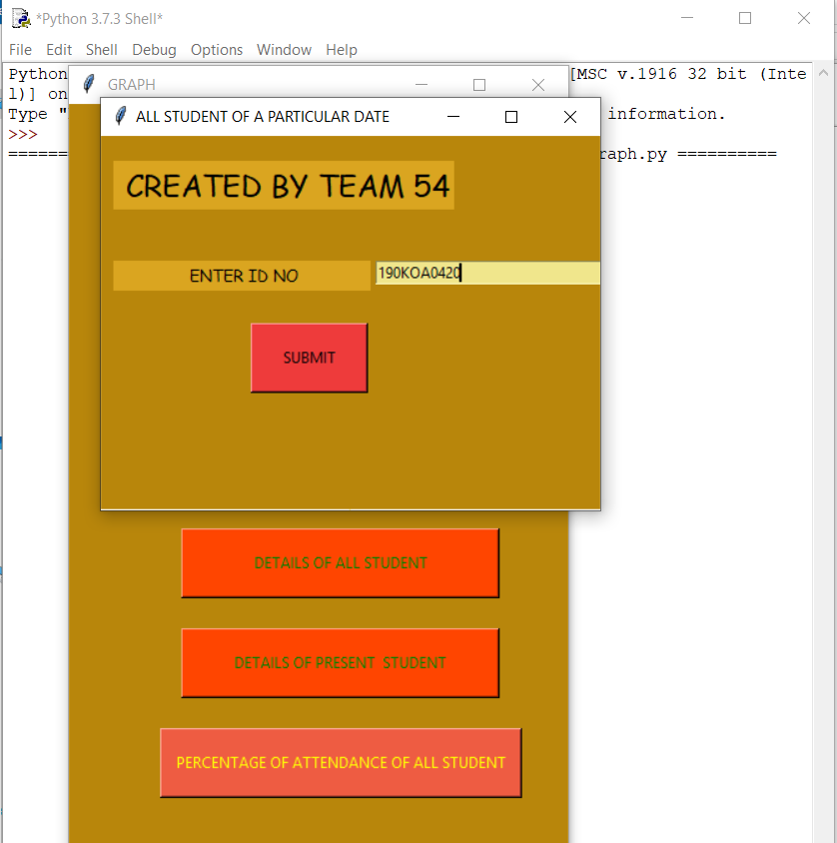
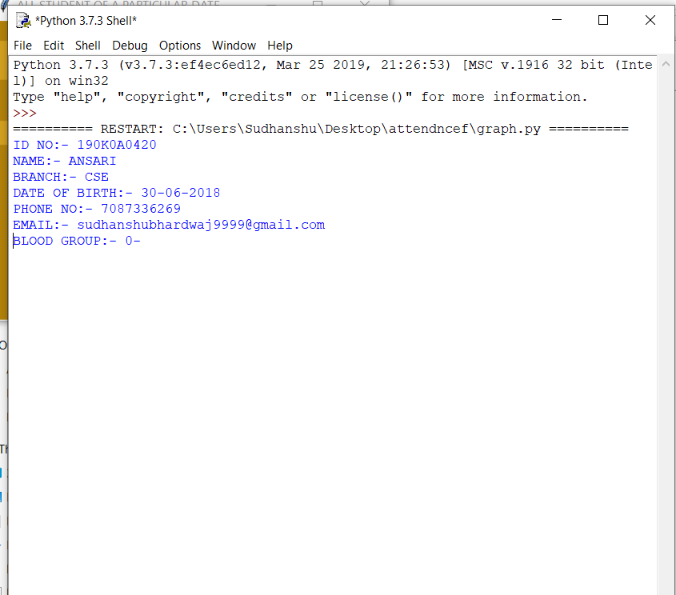

Slide 12
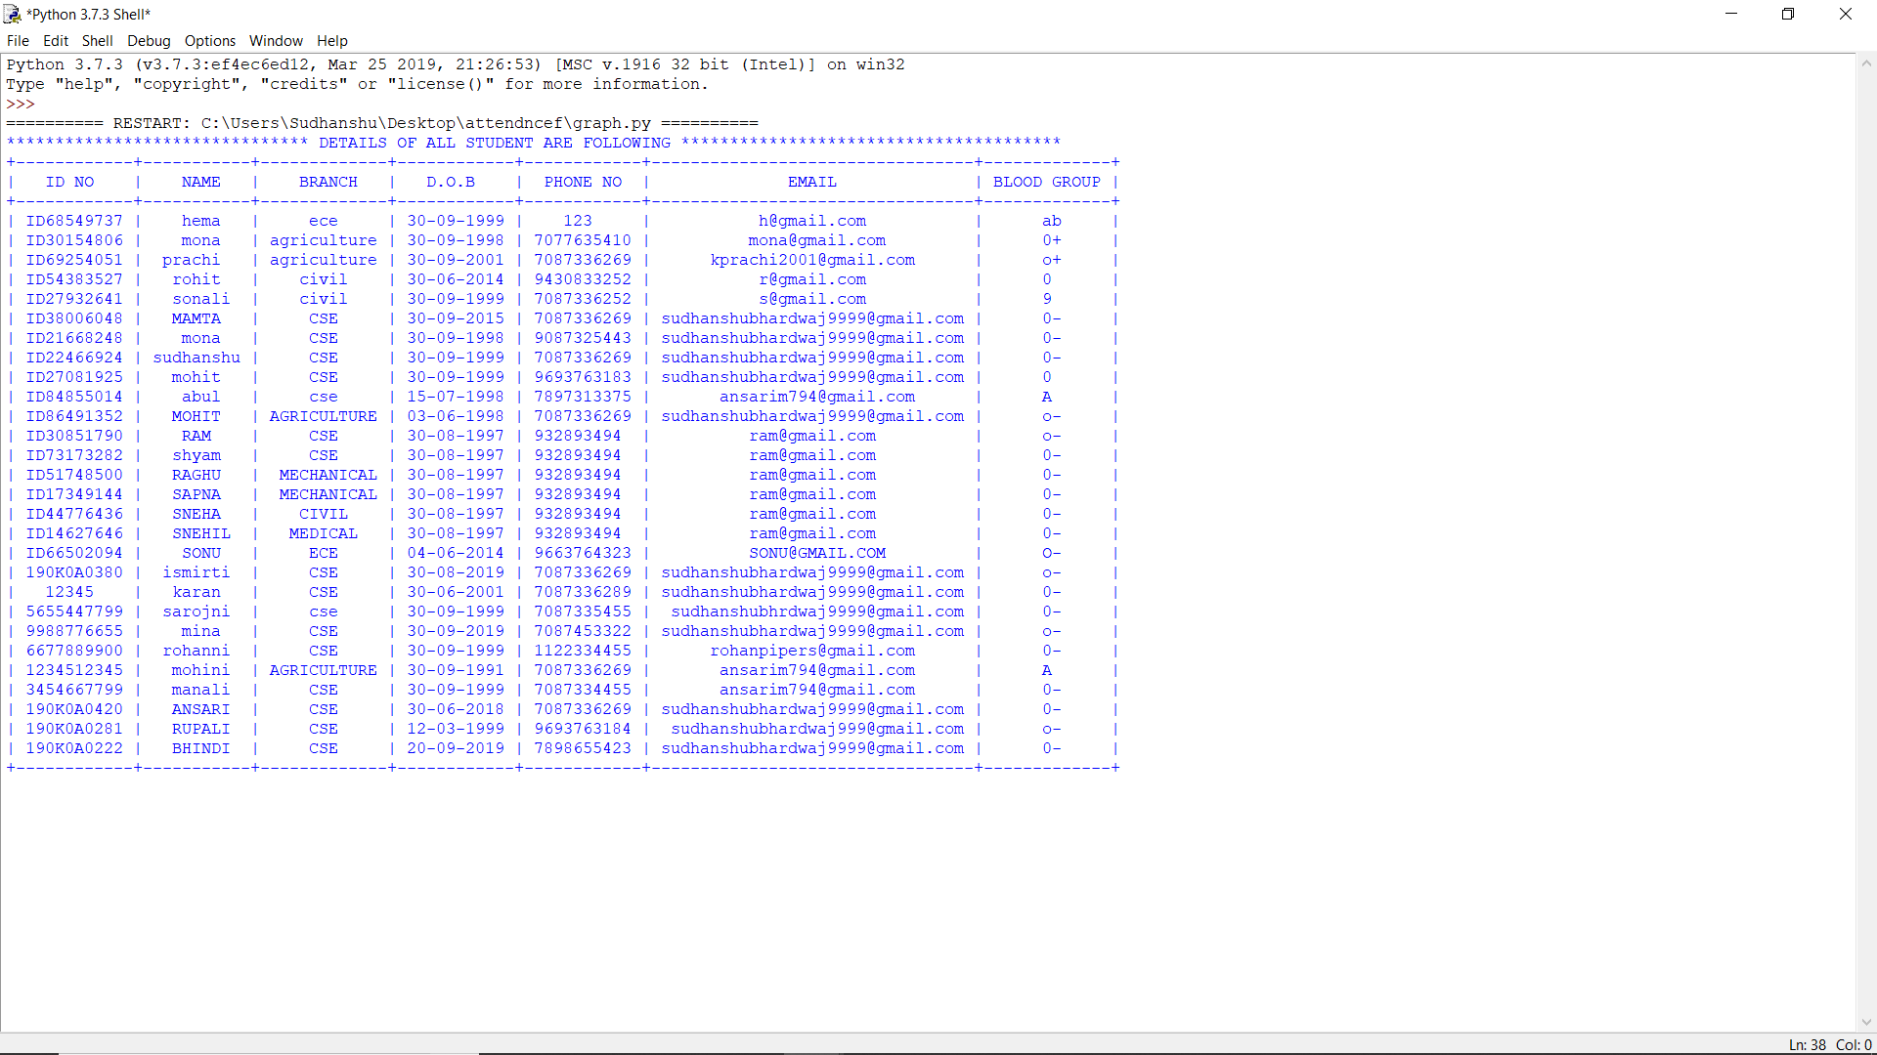

Slide 13
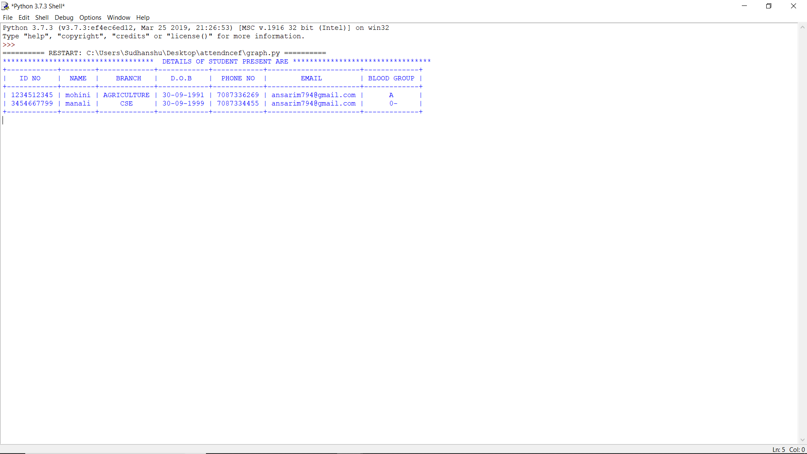
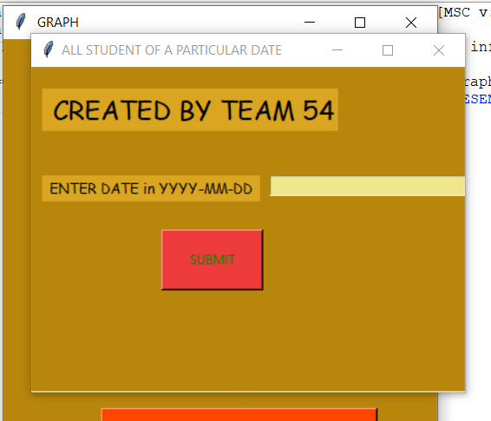

Slide 14
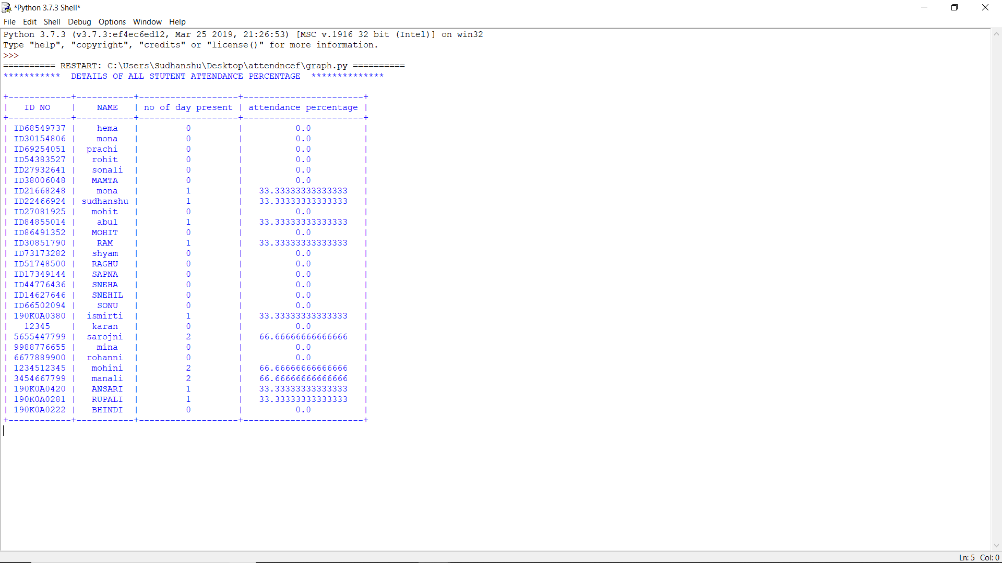

Slide 15
BENEFITS OF OUR MODEL:-
Reduced time consumption
Reduced manpower with paperless record.
Fast and very efficient way of tracking attendance.

Slide 16
THANK YOU!

